Slide 1
Python Programming
Day - 1

Slide 2
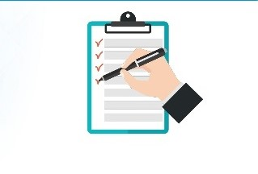
Session Topics
What is Python ?
Why Python ?
Features of Python
Applications
Python Basics

Slide 3
What is Python ?
1
Python is a high level, interpreted language with dynamic semantics and easy syntax
Created by Guido Van Rossum in 1989.
Python is a case-sensitive language.

Slide 4
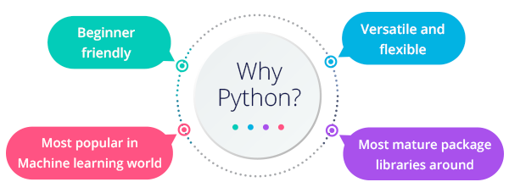
Why Python ?
2

Slide 5
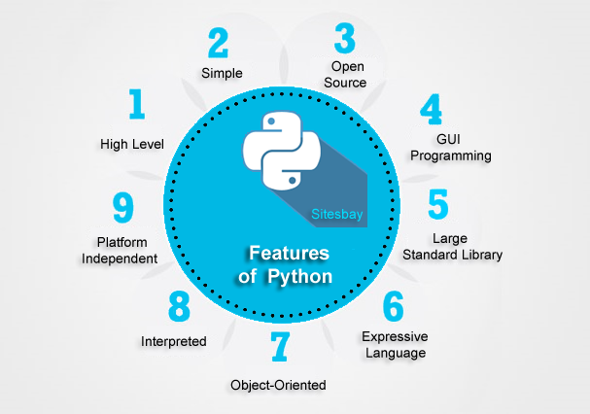
Features of Python
3

Slide 6
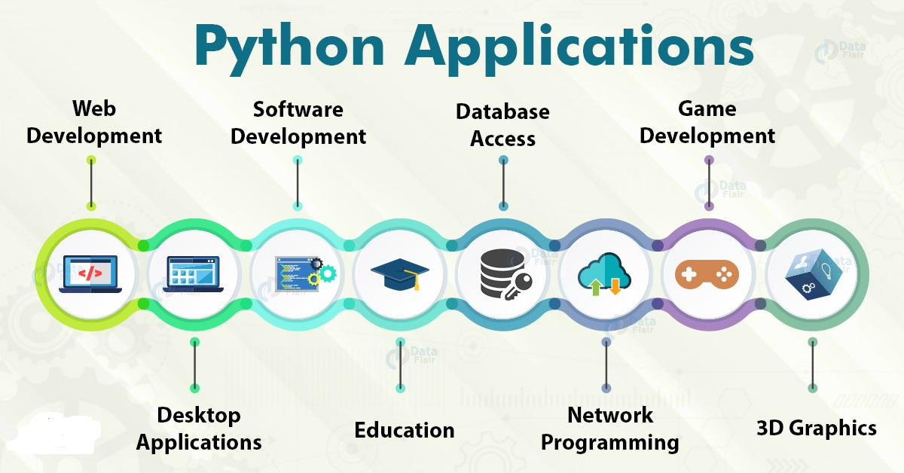
Applications of Python
4

Slide 7
